Slide 1
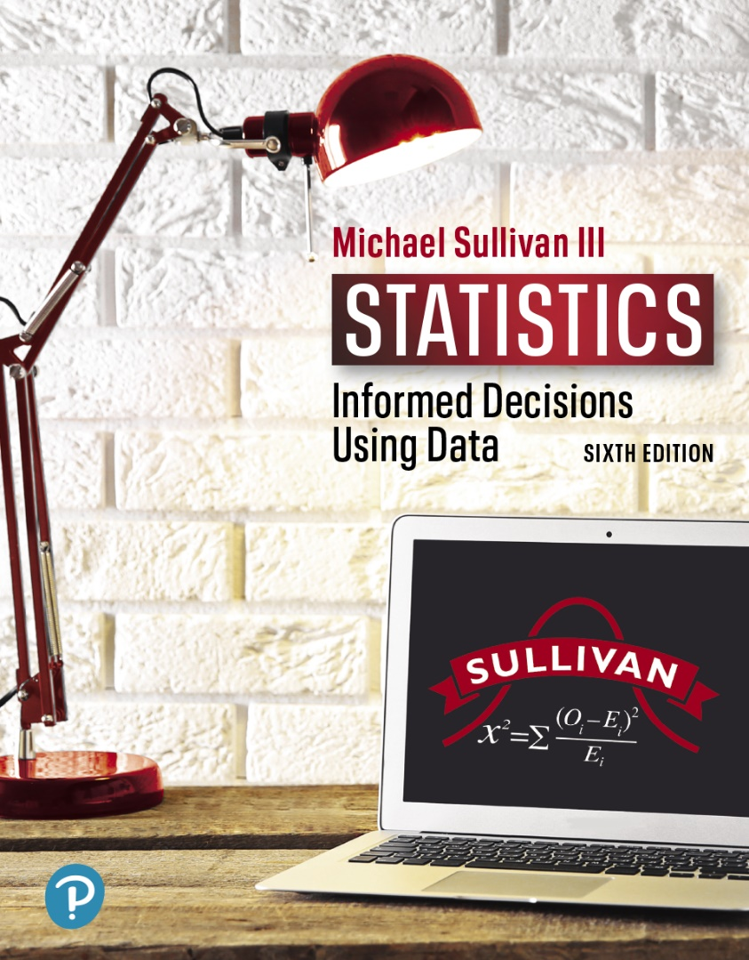
STATISTICS
INFORMED DECISIONS USING DATA
Chapter 13
Comparing Three or More Means
13-1

Slide 2

13.1 Comparing Three or More
Means (One-Way Analysis
of Variance)
Learning Objectives
Verify the requirements to perform a one-way ANOVA
Test a hypothesis regarding three or more means using one-way ANOVA
13-2

Slide 3
Analysis of Variance (ANOVA) is an inferential method used to test the equality of three or more population means.
13-3

Slide 4
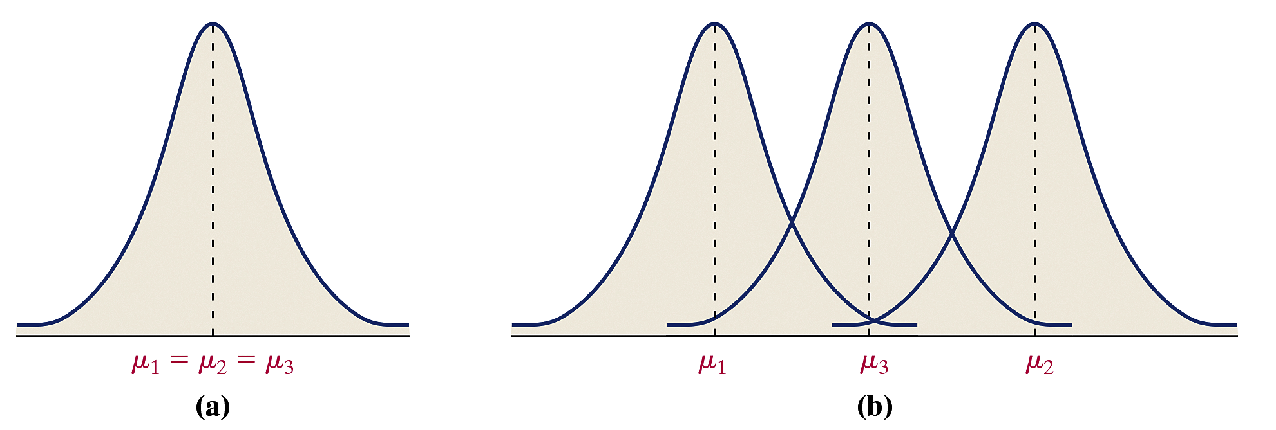
Suppose we are testing a hypothesis regarding three population means; we have
H₀: μ₁ = μ₂ = μ₃
H₁: At least one population mean is different
from the others
Figure (a) shows the distribution of each population if the null hypothesis is true, and Figure (b) shows one example of what the distributions of the populations might look like if the alternative hypothesis is true.
13-4

Slide 5
CAUTION!
Do not test H₀: μ₁ = μ₂ = μ₃ by conducting three separate hypothesis tests, because the probability of making a Type I error will be much higher than α.
13-5

Slide 6
Analysis of variance (ANOVA) involves a comparison of two estimates of the same population variance.
The procedure used in this section is called one-way ANOVA because only one factor distinguishes the various populations in the study.
13-6

Slide 7
Objective 1
Verify the Requirements to Perform a One-Way ANOVA
13-7

Slide 8
Requirements to Perform a One-Way ANOVA Test
There must be k simple random samples, one from each of k populations, or a randomized experiment with k treatments.
The k samples are independent of each other; that is, the subjects in one group cannot be related in any way to subjects in a second group.
The populations are normally distributed.
The populations must have the same variance; that is, each treatment group has the population variance σ².
13-8

Slide 9
The methods of one-way ANOVA are robust, so small departures from the normality requirement will not significantly affect the results of the procedure. In addition, the requirement of equal population variances does not need to be strictly adhered to, especially if the sample size for each treatment group is the same. Therefore, it is worthwhile to design an experiment in which the samples from the populations are roughly equal in size.
13-9

Slide 10
Verifying the Requirement of Equal
Population Variance
The one-way ANOVA procedures may be used if the largest sample standard deviation is no more than twice the smallest sample standard deviation.
13-10

Slide 11
EXAMPLE Testing the Requirements of One-Way
(1 of 4) ANOVA
Prosthodontists specialize in the restoration of oral function, including the use of dental implants, veneers, dentures, and crowns. Since repairing chipped veneer is less costly and time-consuming than complete restoration, a researcher wanted to compare the shear bond strength of different repair kits for repairs of chipped porcelain veneer in fixed prosthodontics. He randomly divided 20 porcelain specimens into four treatment groups. Group 1 specimens used the Cojet system, group 2 used the Silistor system, group 3 used the Cimara system, and group 4 specimens used the Ceramic Repair system. At the conclusion of the study, shear bond strength (in megapascals, MPa) was measured according to ISO 10477.
The data in Table 1, on the next slide, are based on the results of the study. Verify that the requirements to perform one-way ANOVA are satisfied.
13-11

Slide 12
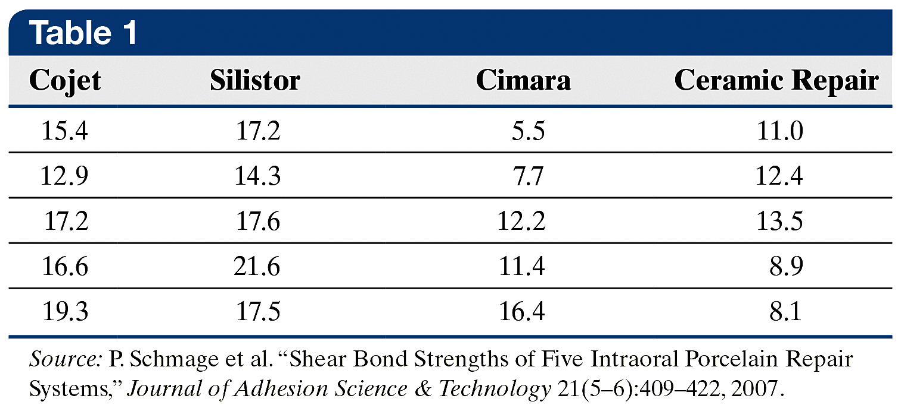
EXAMPLE Testing the Requirements of One-Way
(2 of 4) ANOVA
1. The data are obtained from a completely randomized design
with four treatments.
2. The specimens were assigned randomly to each group, so the
samples are independent.
13-12

Slide 13
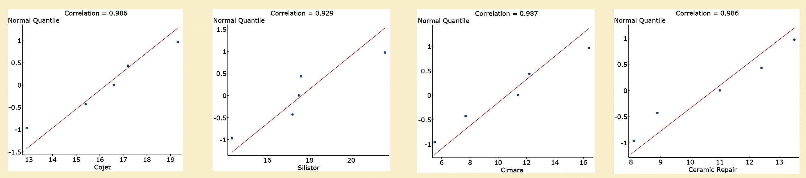
EXAMPLE Testing the Requirements of One-Way
(3 of 4) ANOVA
3. The figure shows the normal probability plots for each group
drawn in StatCrunch along with the correlation between the
score and expected z-score. Each correlation is greater than
0.880, the critical value for n = 5 observations from Table VI.
Therefore, it is reasonable to conclude each data set comes
from a population that is normally distributed.
13-13

Slide 14

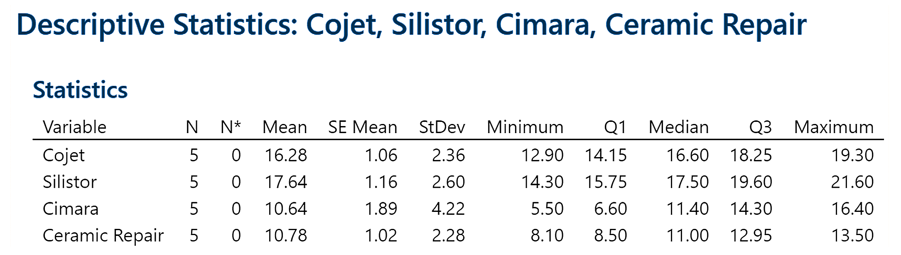
EXAMPLE Testing the Requirements of One-Way
(4 of 4) ANOVA
4. The sample standard deviations for each sample are computed
using Minitab and presented as part of the figure shown. The
largest standard deviation is 4.22 MPa; the smallest is 2.28
MPa. Because the largest standard deviation is not more than
twice the smallest the requirement of
equal population variances is satisfied.
Since all four requirements are satisfied, we can perform a one-way ANOVA.
13-14

Slide 15
Objective 2
Test a Hypothesis Regarding Three or More Means Using One-Way ANOVA
13-15

Slide 16
The basic idea in one-way ANOVA is to determine if the sample data could come from populations with the same mean, μ, or suggests that at least one sample comes from a population whose mean is different from the others.
To make this decision, we compare the variability among the sample means to the variability within each sample.
13-16

Slide 17
We call the variability among the sample means the between-sample variability, and the variability of each sample the within-sample variability.
If the between-sample variability is large relative to the within-sample variability, we have evidence to suggest that the samples come from populations with different means.
13-17

Slide 18
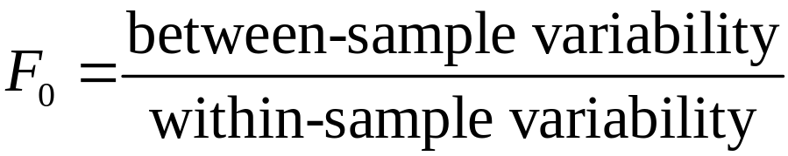
ANOVA F-Test Statistic
The analysis of variance F-test statistic is given by
13-18

Slide 19
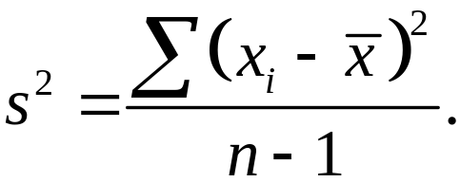
The computation of the F-test statistic is based on mean squares. A mean square is an average (mean) of squared values.
The population variance, σ², is estimated by the sample variance
The numerator of s² is called the sum of squares. It gives a measure of the variability of the data about the sample mean. The denominator of s², n – 1, represents the degrees of freedom.
13-19

Slide 20
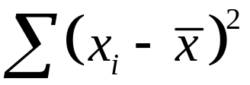

The quantity represents the total variability about the mean of the entire set of data, and is called the total sum of squares or SS (Total).
The variability within each treatment group, or within-sample variability estimate of σ² (or denominator of the F-test statistic), is a weighted average of the sample variances from each treatment (or sample), where the weights are based on the size of each sample. We call this estimate of σ² the mean square due to error, or MSE. To find the MSE, first compute the sum of squares due to error, or SSE.
13-20

Slide 21
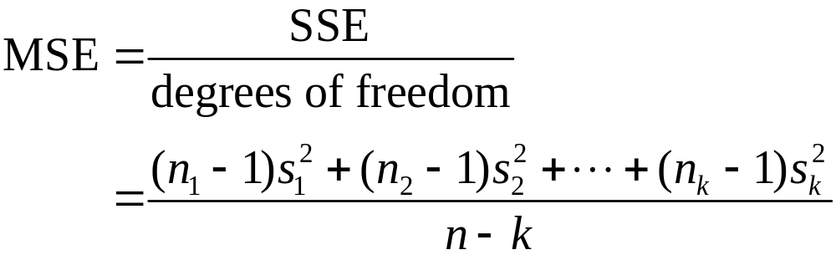
The mean square due to error is an unbiased estimator of σ² whether the null hypothesis of equal means is true or not. It is computed as follows:
The between-sample variability estimate of σ² (or numerator of the F-test statistic) is called the mean square due to treatment, or MST, since any differences in the sample means could be attributed to the different levels of the treatment.
13-21

Slide 22
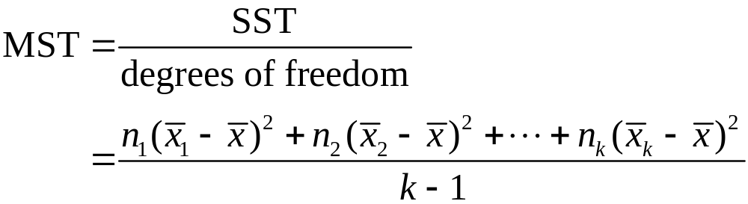
To find the MST, first compute the sum of squares due to treatment or SST. The SST is the sum of the squared
differences between each treatment (or sample) mean and the overall mean, where each squared difference is weighted by its sample size. That is,
Since there are k sample means and SST measures how these vary from the overall mean, this sum of squares has
k – 1 degrees of freedom. The MST is computed as follows:
13-22

Slide 23
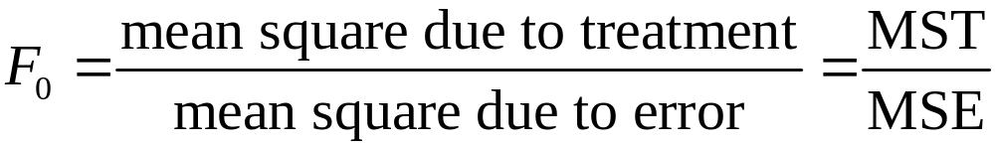
F-Test Statistic
13-23

Slide 24





Computing the F-Test Statistic
Step 1 Compute the sample mean of the combined data set by adding up all the observations and dividing by the number of observations. Call this value
Step 2 Find the sample mean for each sample (or treatment). Let represent the sample mean of sample 1, represent the sample mean of sample 2, and so on.
Step 3 Find the sample variance for each sample (or treatment). Let represent the sample variance for sample 1, represent the sample variance for sample 2, and so on.
13-24

Slide 25
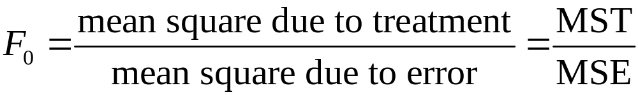
Computing the F-Test Statistic
Step 4 Compute the sum of squares due to treatments, SST, and the sum of squares due to error, SSE.
Step 5 Divide each sum of squares by its corresponding degrees of freedom (k – 1 and n – k, respectively) to obtain the mean squares, MST and MSE.
Step 6 Compute the F-test statistic:
13-25

Slide 26
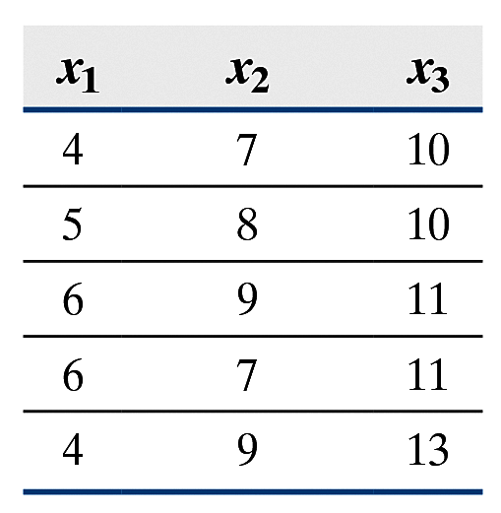
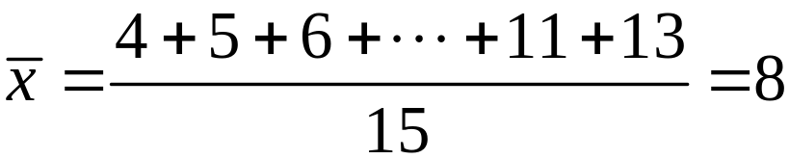
EXAMPLE Computing the F-Test Statistic by Hand
(1 of 3)
Compute the F-test statistic for the data in Table 2(a). The data are presented again for convenience.
Step 1 Compute the mean of the entire set of data, or the overall mean.
13-26

Slide 27

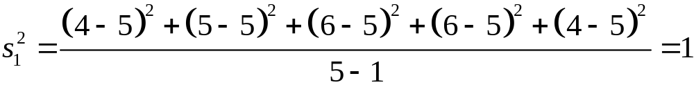

EXAMPLE Computing the F-Test Statistic by Hand
(2 of 3)
Step 2 Find the sample mean for each treatment (or sample).
Step 3 Find the sample variance for each treatment (or sample).
Step 4 Compute the sum of squares due to treatment, SST, and the sum of squares due to error, SSE.
SST = 5(5 – 8)² + 5(8 – 8)² + 5(11 – 8)² = 90
SSE = (5 – 1)1 + (5 – 1)1 + (5 – 1)1.5 = 14
13-27

Slide 28
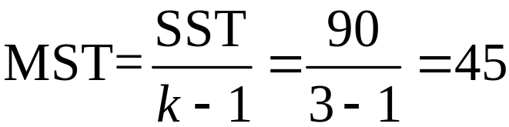
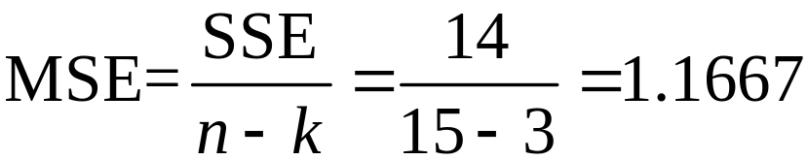
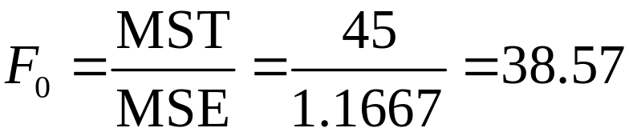
EXAMPLE Computing the F-Test Statistic by Hand
(3 of 3)
Step 5 Compute the mean square due to treatment, MST, and the mean square due to error, MSE.
Step 6 Compute the F-test statistic.
The large value of F₀ suggests that the sample means for each treatment differ.
13-28

Slide 29
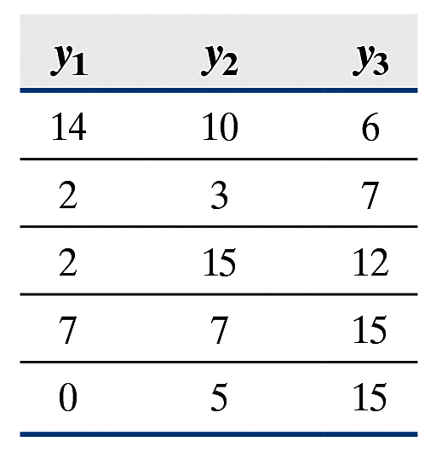
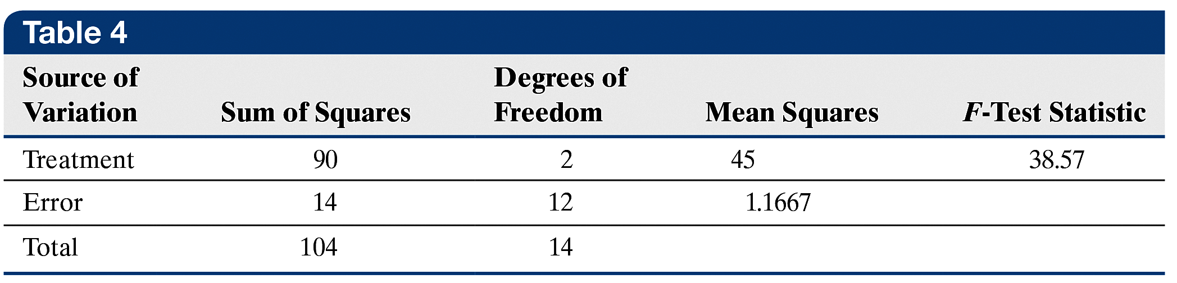
For the data in Table 2(b), MST = 45,
MSE = 24.1667, and F₀ = 1.86.
The small F-test statistic is evidence that the sample means for each treatment do not differ. In addition, notice that
MST = 45 for the data in both tables.
The results of the computations for the data in Table 2(a) that led to the F-test statistic are presented in Table 4, which is called an ANOVA table.
13-29

Slide 30
Decision Rule in the One-Way ANOVA Test
If the P-value is less than the level of significance, α, reject the null hypothesis.
13-30

Slide 31
EXAMPLE Performing One-Way ANOVA Using
(1 of 3) Technology
The researcher in a previous example wants to determine if there is a difference in the mean shear bond strength among the four treatment groups at the α = 0.05 level of
significance.
The null hypothesis is always a statement of “no difference.” So the null hypothesis is that the mean shear bond strength among the four treatment groups is the same, or
versus the alternative hypothesis
H₁: at least one population mean is different from
the others
13-31

Slide 32
EXAMPLE Performing One-Way ANOVA Using
(2 of 3) Technology
The figure on the next slide shows (a) the output from StatCrunch, (b) the output from Minitab, (c) the output from Excel, and (d) the output from a TI-84 Plus C graphing calculator.
Because the P-value, 0.002, is less than the level of significance, α, we reject the statement in the null hypothesis. There is sufficient evidence to indicate that at least one population mean shear bond strength is different from the others.
13-32

Slide 33
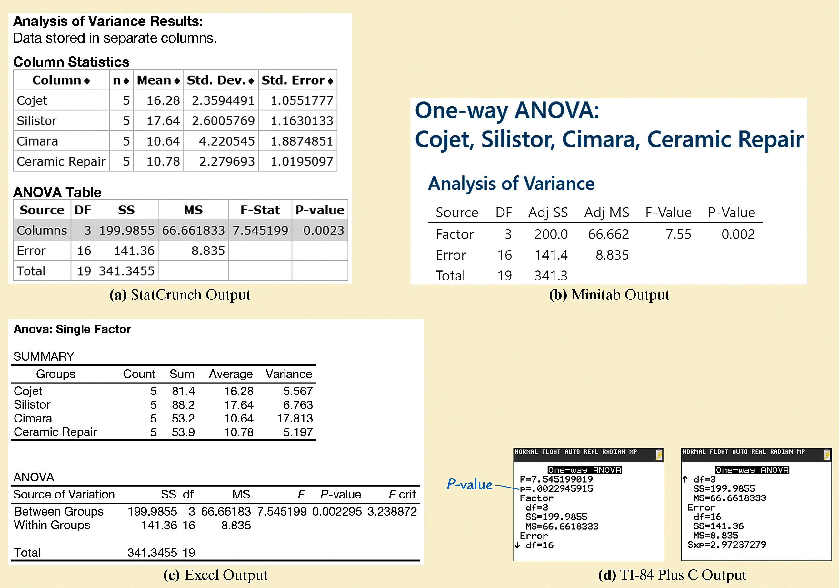
EXAMPLE Performing One-Way ANOVA Using
(3 of 3) Technology
13-33

Slide 34
Whenever performing ANOVA, it is a good idea to present visual evidence that supports the conclusions of the test. Side-by-side boxplots are a great way to help visually reinforce the results of the ANOVA procedure.
The figure on the next slide shows the side-by-side boxplots of the data presented in Table 1. The boxplots support the ANOVA results from the previous example.
13-34

Slide 35
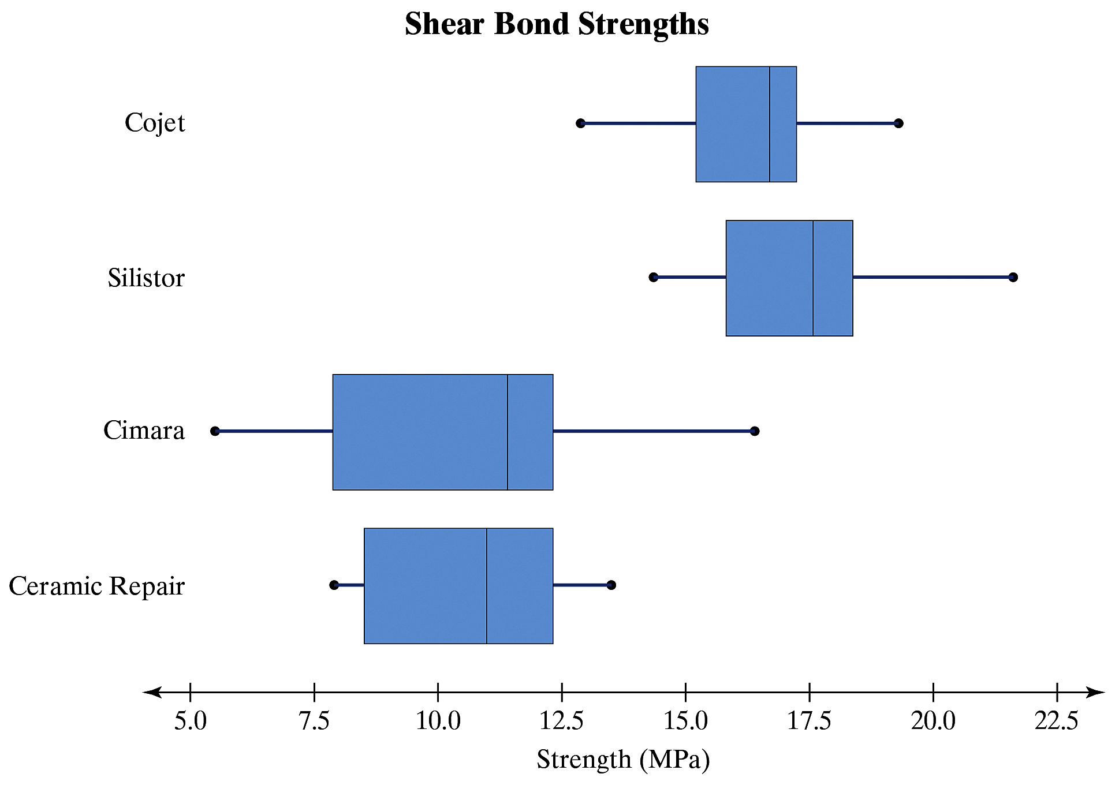
13-35

Slide 36
If we were conducting this ANOVA test by hand using the classical method, we would compare the F-test statistic with a critical F-value. The ANOVA test is a right-tailed test, so the critical F-value is the F-value whose area in the right tail is α with k – 1 degrees of freedom in the numerator and n – k degrees of freedom in the denominator.
13-36

Slide 37
Verifying the Normality Requirement in a One-Way ANOVA
One requirement that must be satisfied to conduct a one-way ANOVA is that the k populations must be normally distributed. We verified this requirement in the shear
bond strength example by drawing normal probability plots for each of the k = 4 samples to see if the plots suggested that the data could come from a population that is normally distributed.
A potential problem with this approach is that if the sample sizes are small, then drawing normal probability plots for each sample does not shed enough light on whether the normality requirement is satisfied.
13-37

Slide 38
EXAMPLE Verifying the Normality Requirement by
(1 of 3) Analyzing Residuals
Verify the normality requirement for the data analyzed in the example that used Table 1.
13-38

Slide 39
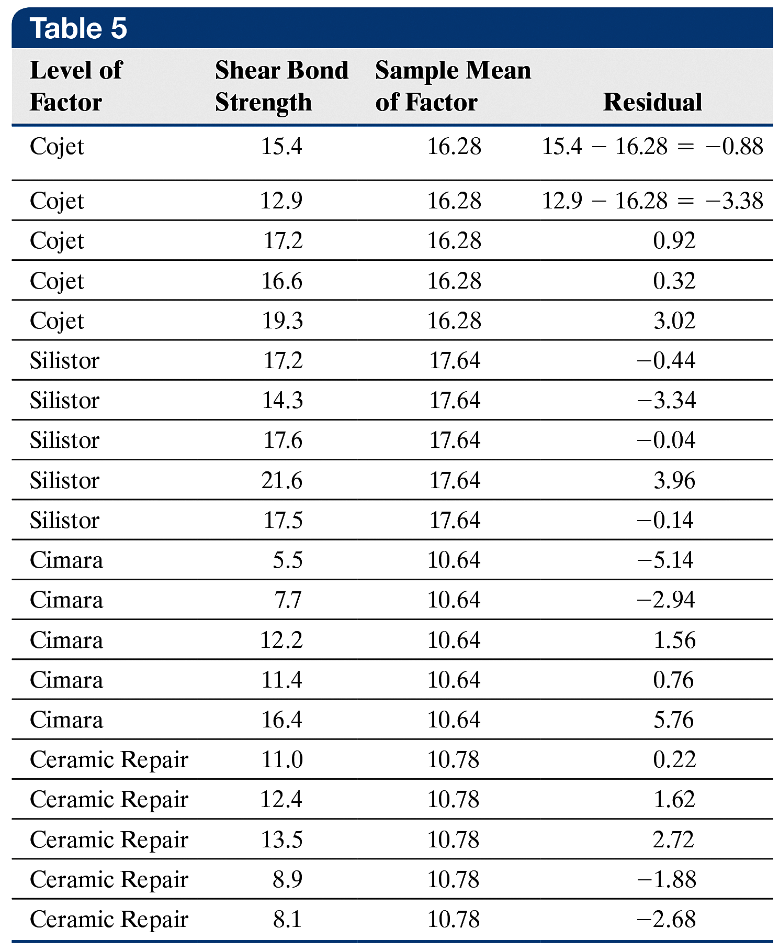
EXAMPLE Verifying the Normality Requirement by
(2 of 3) Analyzing Residuals
The first two columns of Table 5 show the level of the factor and the value of the response variable, shear bond strength. Column 3 of Table 5 shows the sample mean for each level of the factor. Column 4 shows the residuals.
13-39

Slide 40
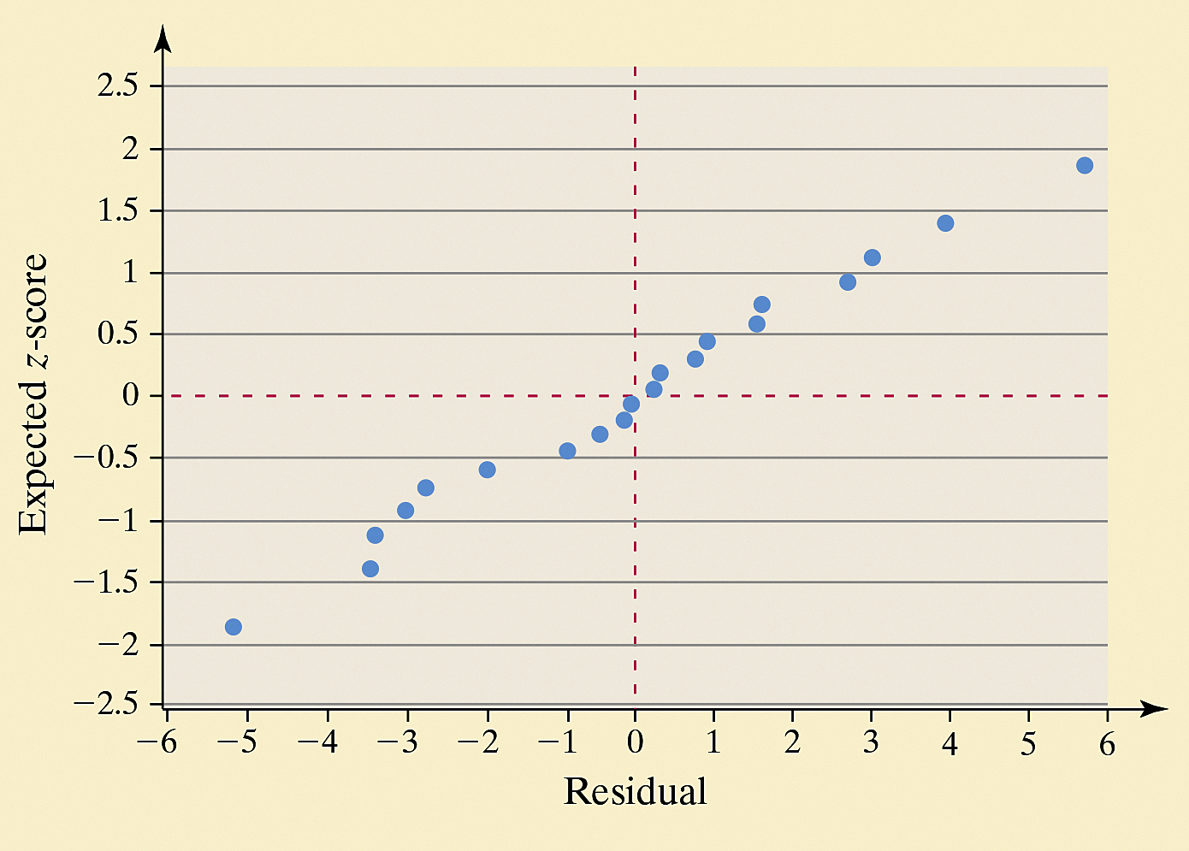
EXAMPLE Verifying the Normality Requirement by
(3 of 3) Analyzing Residuals
The figure shows the normal probability plot of the residuals. The correlation between the residuals and expected z-scores is 0.993 [Tech: 0.991].
Because 0.993 > 0.951
(critical value from
Table VI with n = 20),
it is reasonable to
conclude the residuals
are normally distributed.
13-40

Slide 41
13.2 Post Hoc Tests on One-Way
Analysis of Variance
Learning Objectives
Perform the Tukey Test
13-41

Slide 42
When the results from a one-way ANOVA lead us to conclude that at least one population mean is different from the others, we can make additional comparisons between the means to determine which means differ significantly. The procedures for making these comparisons are called multiple comparison methods.
13-42

Slide 43
Objective 1
Perform the Tukey Test
13-43

Slide 44
The Tukey test, also known as the Honestly Significant Difference Test and the Wholly
Significant Difference Test, compares pairs of means after the null hypothesis of equal means has been rejected.
13-44

Slide 45
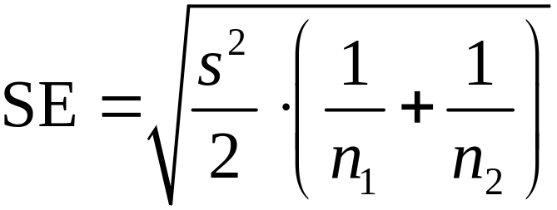
The computation of the test statistic for Tukey’s test for comparing pairs of means follows the same logic as the test for comparing two means from independent sampling. However, the standard error that is used is
where s² is the mean square error estimate (MSE) of σ² from the one-way ANOVA, n₁ is the sample size from population 1, and n₂ is the sample size from population 2.
13-45

Slide 46
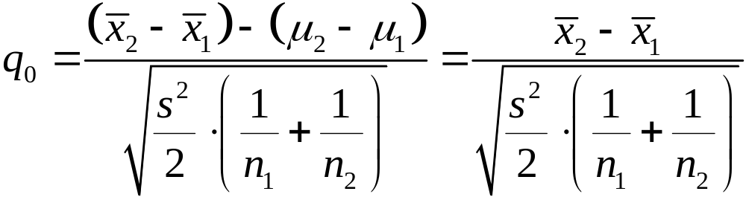

Test Statistic for Tukey’s Test
The test statistic for Tukey’s test when testing
H₀: μ₁= μ₂ versus H₁: μ₁≠ μ₂ is given by
where
s² is the mean square estimate of σ² (MSE) from
ANOVA
n₁ is the sample size from population 1
n₂ is the sample size from population 2
13-46

Slide 47

The q-test statistic follows the Studentized range distribution. The shape of the distribution depends on the error degrees of freedom,ν, and the total number of means being compared, k. We will compare the test statistic, q₀, to a critical value from this distribution,
where α is the level of significance of the test and therefore the probability of making a Type I error. The level of significance α is called the experimentwise error rate or the familywise error rate.
13-47

Slide 48

Critical Value for Tukey’s Test
The critical value for Tukey’s test using a familywise error rate α is given by
where
ν is the degrees of freedom due to error, which is the total number of subjects sampled minus the number of means being compared, or
n – k
k is the total number of means being compared
13-48

Slide 49
EXAMPLE Finding the Critical Value from the Studentized
(1 of 2) Range Distribution
Find the critical value from the Studentized range distribution with ν = 7 degrees of freedom and k = 3 degrees of freedom, with a familywise error rate α = 0.05.
13-49

Slide 50
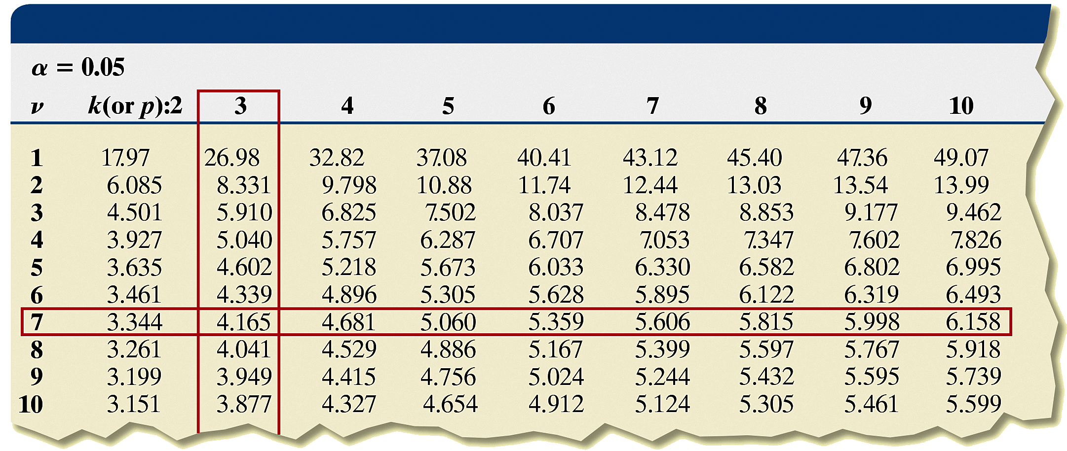
EXAMPLE Finding the Critical Value from the Studentized
(2 of 2) Range Distribution
The critical value is q_{0.05,7,3} = 4.165.
13-50

Slide 51


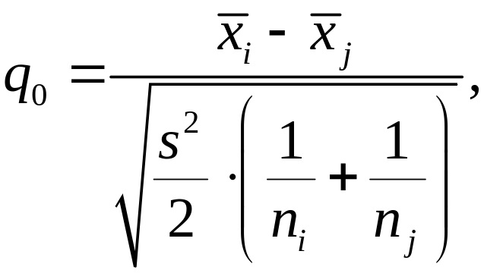
Tukey’s Test
After rejecting the null hypothesis H₀: μ₁= μ₂= ··· = μ_{k}
use Steps 1 through 6 to compare pairs of means for significant differences.
Step 1 Arrange the sample means in ascending order.
Step 2 Compute the pairwise differences
Step 3 Compute the test statistic,
for each pairwise difference.
13-51

Slide 52

Tukey’s Test
Step 4 Determine the critical value, where α is the level of significance (the familywise error rate).
Step 5 If reject the null hypothesis H₀: μ_{i} = μ_{j} and conclude that the means are significantly different.
Step 6 Compare all pairwise differences to identify which means differ.
13-52

Slide 53


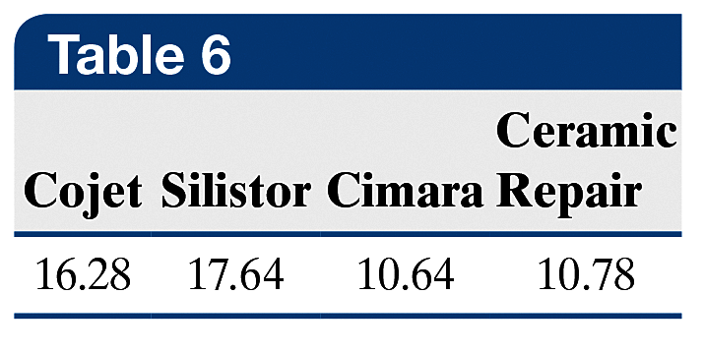
EXAMPLE Performing Tukey’s Test by Hand
(1 of 5)
In a previous example, we rejected the null hypothesis
Use Tukey’s test to determine which pairwise means differ using a familywise error rate of α = 0.05.
Step 1 The means for each category are given in Table 6. The means, in ascending order, are
13-53

Slide 54


EXAMPLE Performing Tukey’s Test by Hand
(2 of 5)
Step 2 Now compute the pairwise differences,
That is, subtract the smaller sample mean from the larger sample mean, as shown in Column 2 of Table 7, on the next slide. It is helpful to write the differences in descending order.
Step 3 Compute the test statistic q₀ for each pairwise difference. From the ANOVA table shown previously, we have the mean square error = 8.835. This is the value of s² in the computation of the test statistic q₀. The test statistic for each pairwise difference is shown in Column 3 of Table 7.
13-54

Slide 55
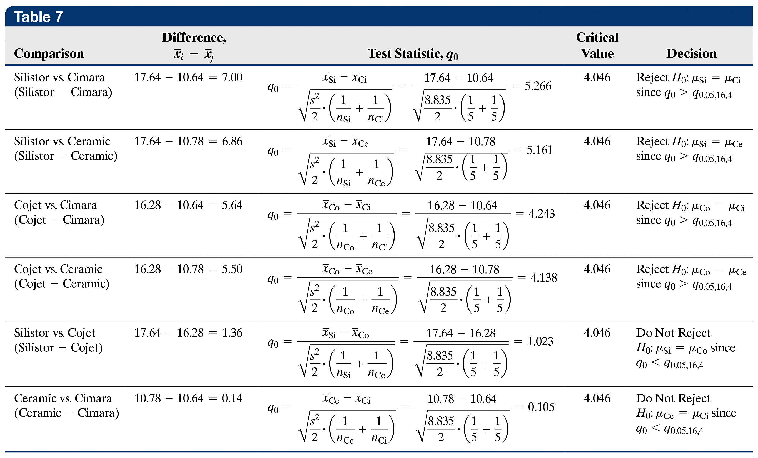
EXAMPLE Performing Tukey’s Test by Hand
(3 of 5)
13-55

Slide 56
EXAMPLE Performing Tukey’s Test by Hand
(4 of 5)
Step 4 Find the critical value using an α = 0.05 familywise error rate with ν = n – k = 20 – 4 = 16 and k = 4. From Table X, the critical value is q_{0.05,16,4} = 4.046. (If the critical value were not in Table X because of the value for ν, use the entry corresponding to the value closest to ν.) The critical value is in Column 4 of Table 7.
Step 5 If q₀ > q_{0.05,16,4}, reject the null hypothesis and state the conclusion in Column 5 of Table 7. By writing the differences in descending order, once we “do not reject H₀,” we can stop because we will not reject smaller differences either!
13-56

Slide 57

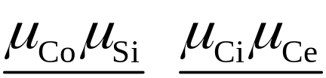
EXAMPLE Performing Tukey’s Test by Hand
(5 of 5)
Step 6 The conclusions of Tukey’s test are
Use lines to indicate which sample means are not significantly different:
The means listed over a common line are equal. So the evidence indicates that veneer repairs using the Cojet or Silistor treatment have the highest shear bond strength.
The Cimara and Ceramic Repair treatments were not significantly different, but were weaker in terms of shear bond strength than the other treatments.
13-57

Slide 58
EXAMPLE Tukey’s Test Using Technology
(1 of 5)
Use Minitab to obtain the results of Tukey’s test for the shear bond strength data from a previous example.
13-58

Slide 59
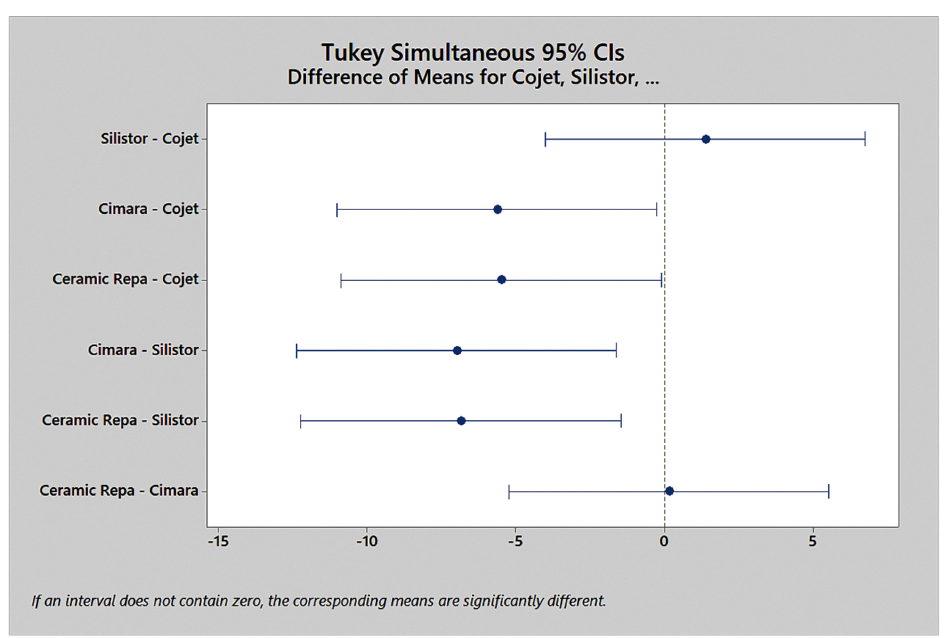
EXAMPLE Tukey’s Test Using Technology
(2 of 5)
The figure shows the results of Tukey’s test using Minitab. Instead of reporting P-values to test each hypothesis that the pairwise means are equal, Minitab reports confidence intervals.
13-59

Slide 60






EXAMPLE Tukey’s Test Using Technology
(3 of 5)
Recall, we can use confidence intervals to test versus (or, equivalently,
by determining whether the interval contains 0. If the interval contains 0, we do not reject the null hypothesis,
but if the interval does not contain 0, we reject the null hypothesis at the α level of significance.
If we reject, we can look at the bounds of the confidence interval to determine which mean (μ₁ or μ₂) is greater. For example, if the interval contains only positive numbers, then is positive, so we have evidence that
μ₁ > μ₂. Similarly, if the confidence interval contains only negative numbers, we have evidence that μ₁ < μ₂.
13-60

Slide 61
EXAMPLE Tukey’s Test Using Technology
(4 of 5)
If we look at the first group of confidence intervals, we are comparing means from the Cojet treatment and the other three treatments. The lower bound on the confidence interval
μ_{Silistor} – μ_{Cojet} is –4.024 MPa and the upper bound is 6.744 MPa. Because the interval contains 0, do not reject the null hypothesis that the mean shear strength of the Silistor treatment is the same as the mean shear strength of the Cojet treatment.
Next, compare the Cojet treatment to the Cimara treatment. The lower bound is –11.024 MPa and the upper bound is – 0.256 MPa. Because the interval does not contain 0, reject the null hypothesis that the mean shear strength of the Cojet treatment is the same as the mean shear strength of the Cimara treatment.
13-61

Slide 62

EXAMPLE Tukey’s Test Using Technology
(5 of 5)
In addition, because is negative, we have evidence that μ_{Co} > μ _{Ci}. Reading the remainder of the output in a similar
manner, we have μ _{Co} > μ _{Ce}, μ _{Si} > μ _{Ci}, μ _{Si} > μ _{Ce}, and
μ _{Ce} = μ _{Ci}.
Summarizing all six statements, μ _{Co} = μ _{Si} > μ _{Ce} = μ _{Ci} which agrees with our results from a previous example.
13-62

Slide 63

Sometimes the results of Tukey’s test are ambiguous. Suppose the null hypothesis H₀: μ₁ = μ₂ = μ₃ = μ₄ is rejected and the results of Tukey’s test indicate the following
It appears that populations 1, 2, and 3 have a population mean that is different from that of populations 3 and 4. Clearly, this is impossible.
13-63

Slide 64
13.3 The Randomized Complete
Block Design
Learning Objectives
Conduct analysis of variance on the randomized complete block design
Perform the Tukey test
13-64

Slide 65
In the completely randomized design, the researcher manipulates a single factor and fixes it at two or more levels and then randomly assigns experimental units to a treatment. This design is not always sufficient because the researcher may be aware of additional factors that cannot be fixed at a single level throughout the experiment.
13-65

Slide 66
The randomized block design is an experimental design that captures more information and therefore reduces experimental error.
13-66

Slide 67
In Other Words
A block is a method for controlling experimental error. Blocks should form a homogenous group. For example, if gender is thought to explain some of the variability in the response variable, remove gender from the experimental error by forming blocks of experimental units with the same gender.
13-67

Slide 68
EXAMPLE Randomized Complete Block Design
(1 of 6)
A researcher wants to determine the tread wear on four different tires after 5000 miles of highway driving. The researcher has four of each brand of tire, four cars, and four drivers. For simplicity, we call the tire types A, B, C, and D. The researcher wants to test H₀: μ_{A} = μ_{B} = μ_{C} = μ_{D} versus the alternative that at least one of the means differs, where μ_{i} represents the mean tread loss for each tire type.
The researcher must first determine the variables that affect tire wear: the type of car, the driver, tire inflation, and road conditions are a few. To save time, the researcher decides to use all four cars in the experiment rather than one. He decides to set the inflation of each tire at 32 pounds, drive the cars on the same oval track, and assign one driver to each car.
13-68

Slide 69
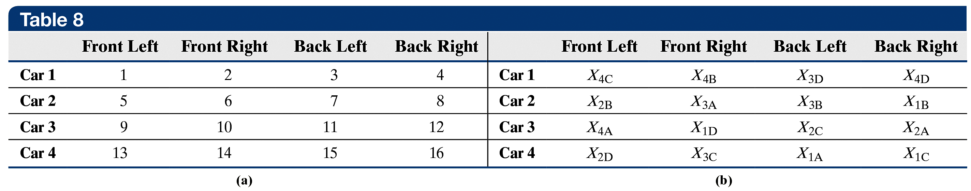
EXAMPLE Randomized Complete Block Design
(2 of 6)
One possible experimental design would be to randomly assign the tires to the cars. First, name each tire: name the first A-tire, tire 1A, the second A-tire, tire 2A, and so on. Then number the car and location of the tires in the cells as shown in Table 8(a).
13-69

Slide 70
EXAMPLE Randomized Complete Block Design
(3 of 6)
Now use a random-number generator to assign the tires to the cars: the first number generated is 15, so place tire 1A on car 4’s back-left position. If the next random number is 12, tire 2A is placed on car 3’s back-right position. We continue until all the tires are assigned to the cars. Let X_{1A} represent the tread loss for the first tire A, let X_{2A} represent the tread loss for the second tire A, and so on. Table 8(b) shows the design we could end up with.
13-70

Slide 71
EXAMPLE Randomized Complete Block Design
(4 of 6)
A quick look at Table 8(b) indicates that tire A is not on car 1, tires C and D are not on car 2, and tire B is not on cars 3 or 4. Therefore, any effect that the car might have on tire wear is not completely accounted for. That is, tire wear variability might be confounded with car variability.
13-71

Slide 72
EXAMPLE Randomized Complete Block Design
(5 of 6)
To resolve this issue, we might require that each car must have
all four tire types on it. This would result in a randomized complete block design. We say complete because each block (car) gets every treatment (tire type). We say randomized because the order in which the treatment is applied within each block is random. To obtain the randomness, randomly assign one treatment (tire brand) to each block (car).
For example, we have four treatments (tire brand), so randomly select an integer between 1 and 4 for the tire number and a second random integer between 1 and 4 for the tire brand. For example, if a random-number generator gives 2 then 1, place tire 2 of brand A on car 1.
13-72

Slide 73
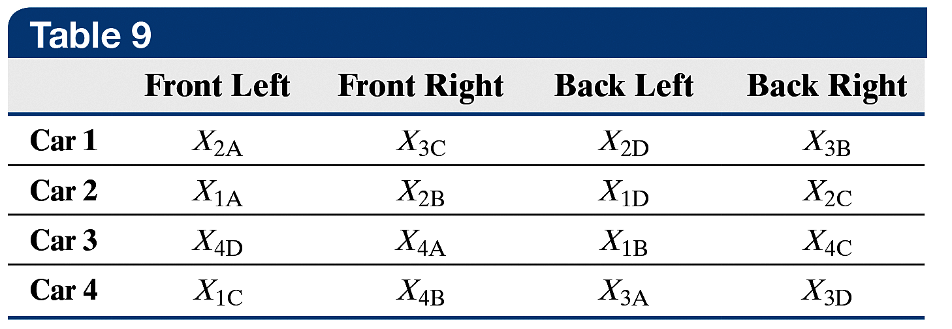
EXAMPLE Randomized Complete Block Design
(6 of 6)
Continuing to place tires on car 1, we repeat the process, but omitting brand A because each brand must be represented on car 1. By randomly assigning
each treatment to each
block, we might end up
with the design in Table 9.
Notice that horizontal lines help the reader see how the blocks are formed. Using this randomized complete block design, the null hypothesis is
H₀: μ_{A} = μ_{B} = μ_{C} = μ_{D}
versus
H₁: at least one of the means is different
13-73

Slide 74
CAUTION!
When we block, we are not interested in determining whether the block is significant. We only want to remove experimental error to reduce the mean square error.
13-74

Slide 75
Objective 1
Conduct Analysis of Variance on the Randomized Complete Block Design
13-75

Slide 76
Requirements for Analyzing Data from a
Randomized Complete Block Design
The response variable for each of the k
populations must be normally distributed.
The response variable for each of the k
populations must have the same variance;
that is, each treatment group has population
variance σ².
13-76

Slide 77
EXAMPLE Analyzing the Randomized Complete
(1 of 5) Block Design
A researcher is interested in the effect of four diets on the weight gain of newborn rats. The researcher randomly assigns rats from the same mother to each treatment so that a set of four rats constitutes a block. In blocking by mother, we are removing any variability in weight gain due to genetic differences. The researcher identifies five mother rats that each had four offspring, for a total of 20 rats. For each block (sibling rats), the researcher randomly assigns the experimental units (rats) to a treatment using randomly generated integers from 1 to 4.
13-77

Slide 78
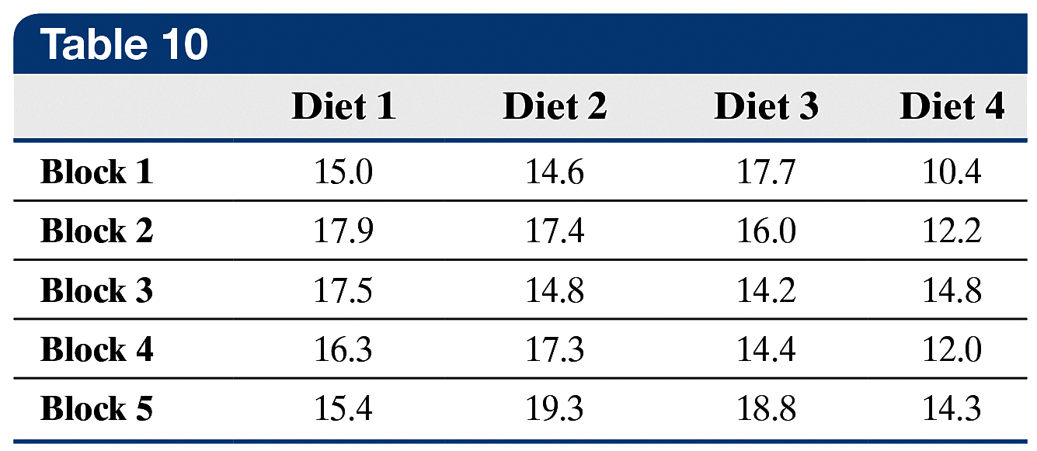
EXAMPLE Analyzing the Randomized Complete
(2 of 5) Block Design
After six months, she records the weight gain of the 20 rats (in grams) and obtains the data in Table 10. Is there
sufficient evidence to conclude that the weight gains of the rats on the four diets differ at the α = 0.05 level of significance?
13-78

Slide 79
EXAMPLE Analyzing the Randomized Complete
(3 of 5) Block Design
We want to test
H₀: μ₁ = μ₂ = μ₃ = μ₄
versus
H₁: at least one of the means is different
A normal probability plot for the data for each of the four diets indicates that the requirement of normality is satisfied. The highest standard deviation, diet 3 with s₃ = 2.018, is not more than twice the lowest standard deviation, diet 1 with s₁ = 1.268, so we can proceed with the analysis.
13-79

Slide 80
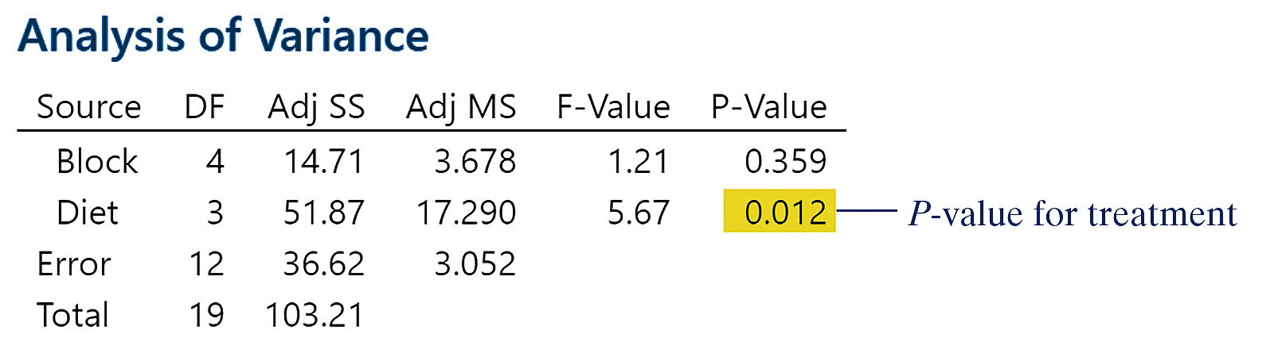
EXAMPLE Analyzing the Randomized Complete
(4 of 5) Block Design
Enter the data into Minitab in three columns. Column 1 represents the block, Column 2 the diet, and Column 3 the response variable, weight gain. So, for the block 1, diet 1 rat, we enter a 1 in column C1, a 1 in C2, and 15 in C3. For the block 1, diet 2 rat, we enter 1 in C1, 2 in C2, and 14.6 in C3, and so on.
The results from Minitab are shown.
13-80

Slide 81
EXAMPLE Analyzing the Randomized Complete
(5 of 5) Block Design
We are not interested in whether the weight gains among the blocks are equal, so we will ignore the P-value for blocks. We are interested in whether the treatment appears to result in different weight gains. The P-value of 0.012 due to treatment is evidence against the null hypothesis of equal weight gain among treatments.
Therefore, we conclude that the treatment, diet, does result in significantly different weight gain. However, we do not know which diets result in different mean weight gains. To determine this, we again rely on the pairwise comparisons of Tukey’s test.
13-81

Slide 82
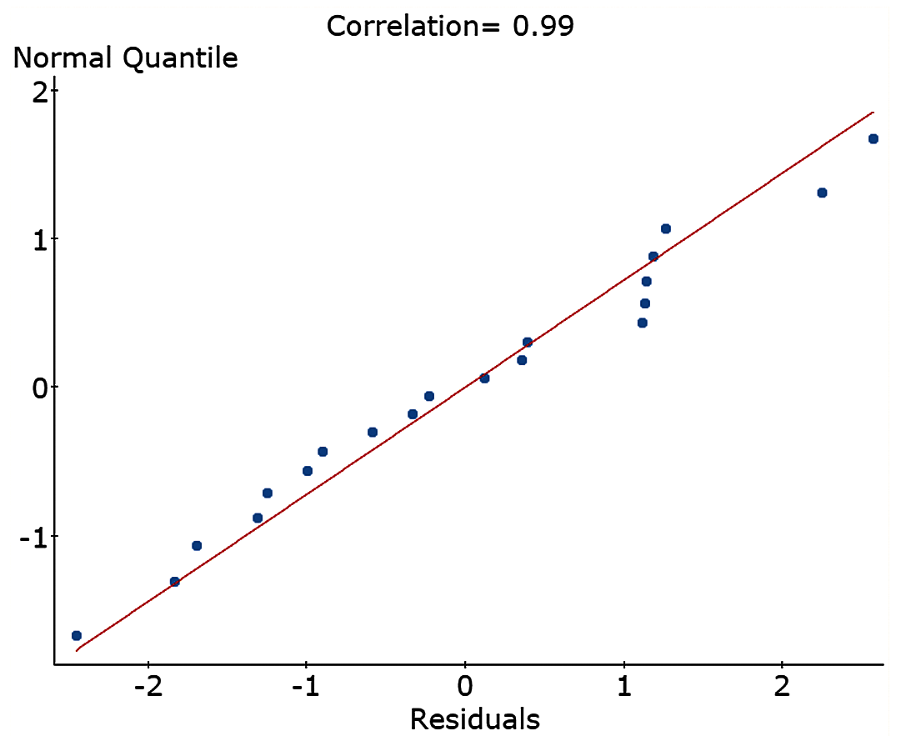
EXAMPLE Verifying the Normality Requirement in the
(1 of 2) Randomized Complete Block Design
Verify the normality requirement for the data analyzed in the previous example.
13-82

Slide 83
EXAMPLE Verifying the Normality Requirement in the
(2 of 2) Randomized Complete Block Design
The figure on the previous slide shows the normal probability plot of the residuals drawn in StatCrunch. The correlation between the residuals and expected z-scores is 0.99. Because 0.99 > 0.959 (critical value from Table VI with n = 25), it is reasonable to conclude the residuals are normally distributed.
13-83

Slide 84
Objective 2
Perform the Tukey Test
13-84

Slide 85
Once the null hypothesis of equal population means is rejected, we can proceed to determine which means differ significantly using Tukey’s test. The steps are identical to those for comparing means in the one-way ANOVA. The critical value is q_{α,ν,k} using a familywise error rate of α with ν = (r – 1)(c – 1) = the error degrees of freedom (r is the number of blocks and c is the number of treatments) and k is the number of means being tested.
13-85

Slide 86
EXAMPLE Multiple Comparisons Using Tukey’s Test
(1 of 3)
Use Tukey’s test to determine which pairwise means differ for the data used in a previous example, with a familywise error rate of α = 0.05, using Minitab.
13-86

Slide 87
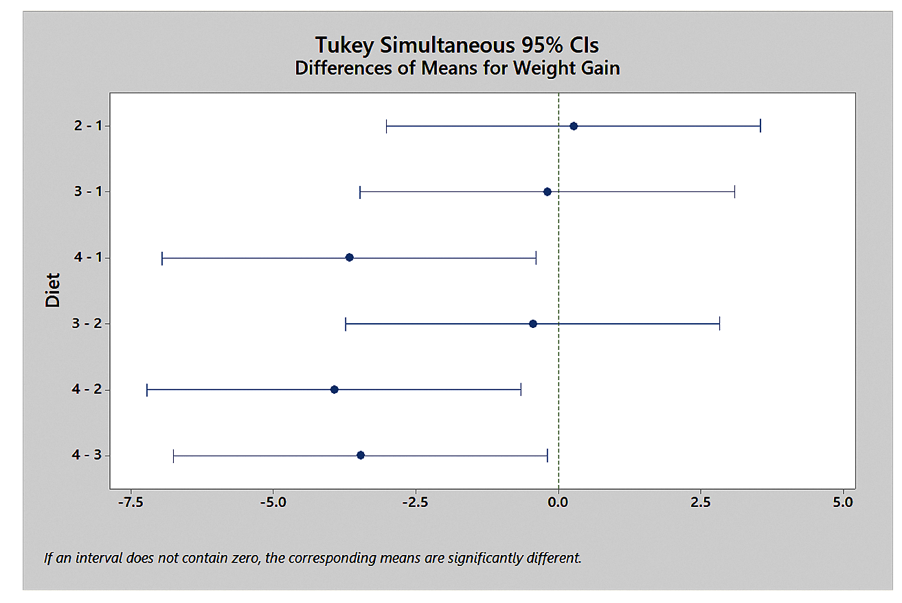
EXAMPLE Multiple Comparisons Using Tukey’s Test
(2 of 3)
The results of Tukey’s test using Minitab are presented in the figure.
13-87

Slide 88

EXAMPLE Multiple Comparisons Using Tukey’s Test
(3 of 3)
Minitab performs pairwise comparisons using confidence intervals. The figure on the previous slide shows the pairwise comparisons using 95% confidence intervals. The first sets of confidence intervals compare diet 1 to diets 2, 3, and 4. We can see that the interval μ_{Diet 4} – μ_{Diet 1} does not include 0. Therefore, we reject the null hypothesis that the mean weight gain from diets 1 and 4 are equal. In addition, the interval contains all negative numbers, so the mean weight gain from diet 1 is greater than that from diet 4. Continuing the comparisons leads us to conclude that diet 4 results in significantly less weight gain
than the other diets.
The conclusions of Tukey’s test are
13-88

Slide 89
13.4 Two-Way Analysis of
Variance
Learning Objectives
Analyze a two-way ANOVA design
Draw interaction plots
Perform the Tukey test
13-89

Slide 90
Objective 1
Analyze a Two-Way ANOVA Design
13-90

Slide 91
Recall, there are two ways to deal with factors:
Control the factors by fixing them at a single level or by fixing them at different levels,
Randomize so that their effect on the response variable is minimized.
In both the completely randomized design and the randomized complete block design, we manipulated one factor to see how varying it affected the response variable.
13-91

Slide 92
In a Two-Way Analysis of Variance design, two
factors are used to explain the variability in the
response variable. We deal with the two factors by manipulating both factors and setting
each at different levels.
We refer to the two factors as factor A and factor B. If factor A has two levels and factor B has two levels, we have a 2 × 2 factorial design (read “two by two factorial design”).
13-92

Slide 93
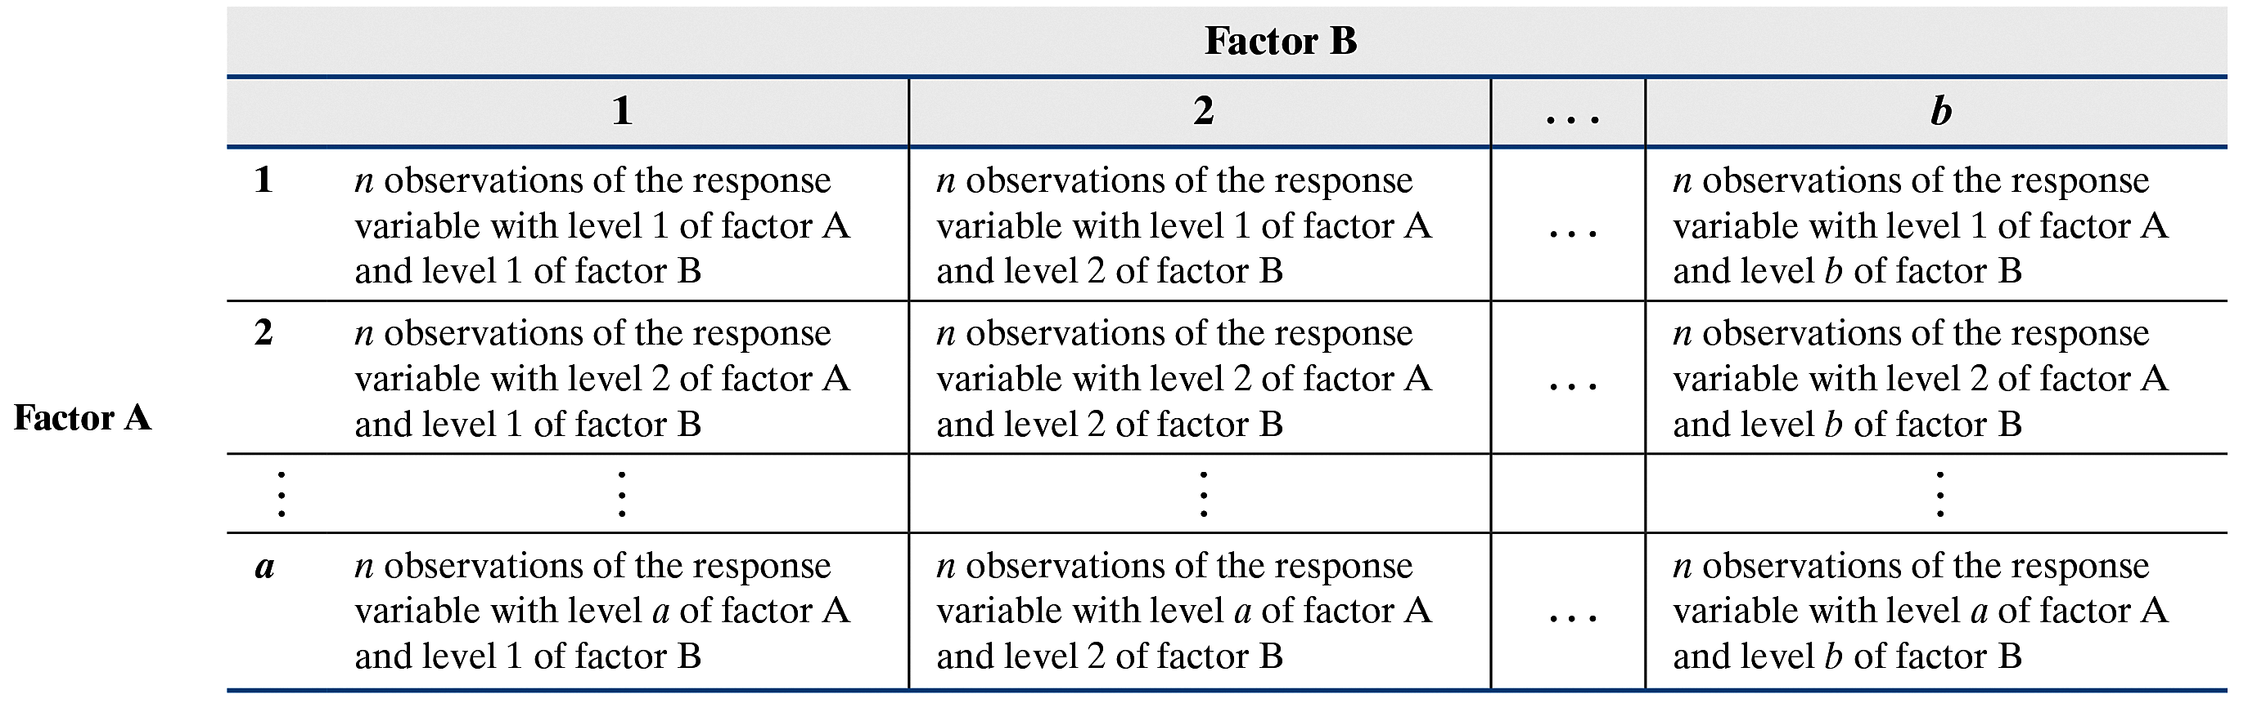
In general, the two-factor design looks as presented in the figure, where there are n replications for each combination of factor A and factor B. Factor A has a levels and factor B has b levels. Each combination of factor levels is a treatment.
13-93

Slide 94
Each of the n observations of the response variable for the different levels of the factors exists within a cell. In a 2 × 3 factorial design, there are six cells with n observations within each cell. Each cell corresponds to a specific treatment.
13-94

Slide 95
EXAMPLE A 2 × 3 Factorial Design
(1 of 2)
High-density lipoprotein (HDL) cholesterol is called good cholesterol because it helps to reduce the amount of bad cholesterol in your system. A pharmaceutical company developed a drug that is meant to increase HDL levels in patients. They obtained volunteers whose HDL cholesterol was roughly the same and randomly assigned them to one of three groups. Group 1, a placebo group, received a sugar tablet. Group 2 received 5 mg of the drug, and group 3 received 10 mg of the drug. In addition to drug dosage, the researchers considered age to be a factor in the analysis; so they divided patients into an 18- to 39-year-old category and a 40 and older category. The design
results in a 2 × 3 factorial design.
13-95

Slide 96
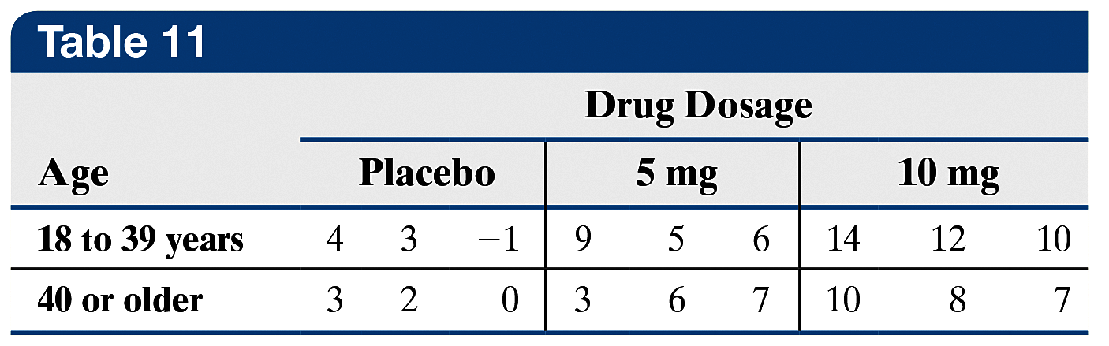
EXAMPLE A 2 × 3 Factorial Design
(2 of 2)
Table 11 shows the increase in HDL cholesterol in milligrams per deciliter (mg/dL) for each patient after 10 weeks. Each cell has n = 3 replications.
13-96

Slide 97
In the factorial design, all levels of factors A and B are combined, so we say that the factors are crossed. The effect of factor A is the change in the response variable that results from changing the level of factor A. The effect of factor B is the change in the response variable that results from changing the level of factor B. Together these two effects are called the main effects. If changes in the level of factor A result in different
changes in the value of the response variable for the different levels of factor B, we say that there is an interaction effect between the factors.
13-97

Slide 98
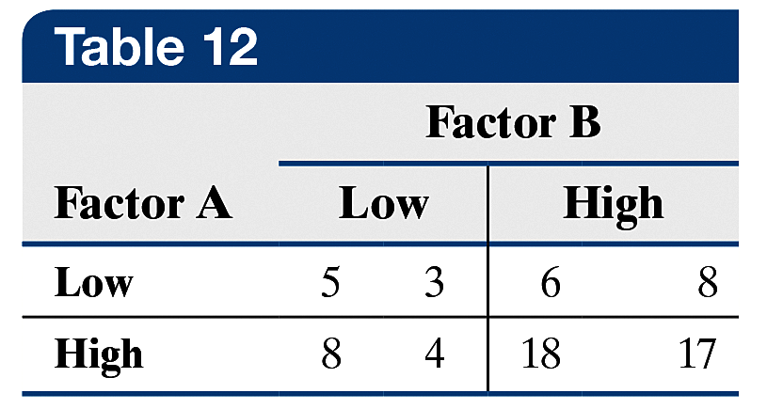
EXAMPLE Main Effects and Interaction Effect
(1 of 6)
Suppose we have two factors, A and B, each fixed at two levels, high and low. The value of the response variable at each level is presented in Table 12. For example, the response variables when both factor A and B are set to low are 5 and 3.
13-98

Slide 99
EXAMPLE Main Effects and Interaction Effect
(2 of 6)
The main effect of factor A is the difference between the mean values of the response variable when factor A is set at high and at low:
Increasing factor A from low level to high level increases the value of the response variable by 6.25 units, on average.
Factor A High
Factor A Low
13-99

Slide 100
EXAMPLE Main Effects and Interaction Effect
(3 of 6)
Factor B High
Factor B Low
Increasing factor B from low level to high level increases the value of the response variable by 7.25 units, on average.
To see the interaction effect between the factors, we first look at one level of one factor and see how changing the other factor affects the value of the response variable.
13-100

Slide 101
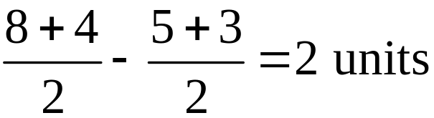
EXAMPLE Main Effects and Interaction Effect
(4 of 6)
For example, if we look only at the low level of factor B, we can see that the effect of changing factor A from low to high is
So, if we are at the low level of factor B, increasing factor A from low to high increases the response variable by 2 units, on average.
Factor A
High
Factor A
Low
13-101

Slide 102
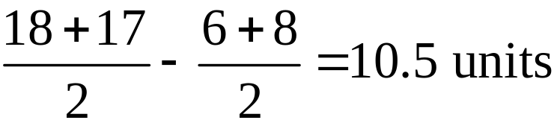
EXAMPLE Main Effects and Interaction Effect
(5 of 6)
If we look only at the high level of factor B, we see the effect of changing factor A from low to high is
So, if we are at the high level of factor B, increasing factor A from low to high increases the response variable by 10.5 units, on average.
The main effect of factor A is 6.25 units, but this is misleading because, at the low level of factor B, the mean increase in the response variable is only 2 units; but at the high level of factor B, the mean increase in the response variable is 10.5 units.
13-102

Slide 103
EXAMPLE Main Effects and Interaction Effect
(6 of 6)
So the increase in the value of the response variable depends on the level of factor B. For this reason, we say there is an interaction effect between factors A and B.
The moral: If interaction between two factors exists, looking at main effects is misleading.
13-103

Slide 104
Requirements to Perform the Two-Way
Analysis of Variance
1. The populations from which the samples are
drawn must be normal.
2. The samples must be independent.
3. The populations must have the same variance.
13-104

Slide 105
In a two-way ANOVA, we test three separate hypotheses.
Hypotheses Regarding Interaction Effect
H₀: there is no interaction effect between the factors
H₁: there is interaction between the factors
Hypotheses Regarding Main Effects
H₀: there is no effect of factor A on the response variable
H₁: there is an effect of factor A on the response variable
H₀: there is no effect of factor B on the response variable
H₁: there is an effect of factor B on the response variable
13-105

Slide 106
Whenever conducting a two-way ANOVA,
we always first test the hypothesis regarding
interaction effect. If the null hypothesis
of no interaction is rejected, we do not interpret the result of the hypotheses involving the main effects. This is because the interaction clouds the interpretation of the main effects.
13-106

Slide 107

EXAMPLE Examining a Two-Way ANOVA
(1 of 7)
In a previous example, we presented data for an experimental drug that was meant to increase HDL cholesterol. The data are represented in Table 13 for convenience.
13-107

Slide 108
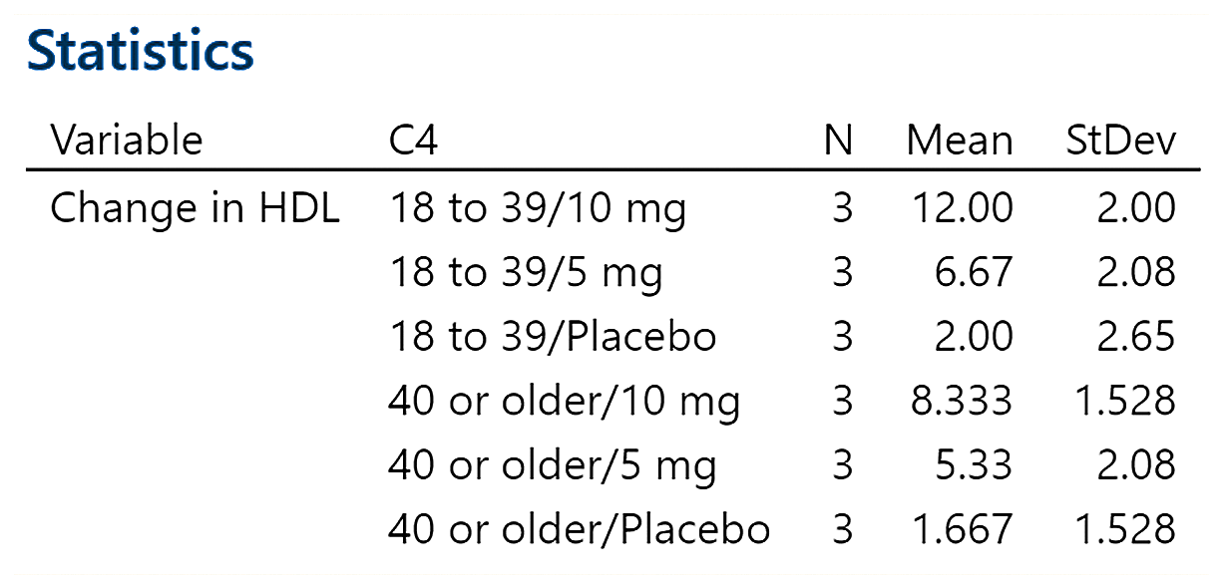
EXAMPLE Examining a Two-Way ANOVA
(2 of 7)
(a) HDL cholesterol levels are known to have a distribution
that is approximately normal. Verify that the largest
sample standard deviation of any cell is no more than
twice the smallest sample standard deviation of any cell.
The descriptive statistics from Minitab are shown in the figure
(a partial printout).
13-108

Slide 109
EXAMPLE Examining a Two-Way ANOVA
(3 of 7)
(a)
The largest sample standard deviation, 2.65 mg/dL, is not
twice as large as the smallest sample standard deviation,
1.528 mg/dL, so the requirement of equal population
variances is satisfied.
13-109

Slide 110
EXAMPLE Examining a Two-Way ANOVA
(4 of 7)
(b) Test whether there is an interaction effect between the
drug dosage and age.
First test the hypotheses
H₀: there is no interaction between drug dosage and age
H_{l}: there is an interaction between drug dosage and age
Enter the data into Minitab. Let column 1 represent the drug
dosage; so enter 1 if the observation is from the placebo
group, 2 if the observation is from 5 mg, and so on. Let
column 2 represent the age and enter 1 for 18- to 39-year-
olds and 2 for 40 or older. Column 3 gets the value of the
response variable, increase in HDL cholesterol. The results of
the two-way ANOVA appear in the figure on the next slide.
13-110

Slide 111
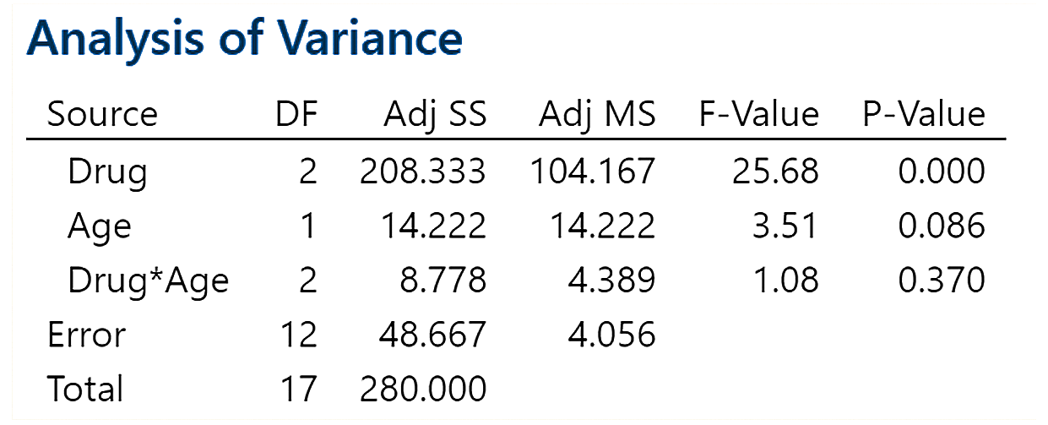
EXAMPLE Examining a Two-Way ANOVA
(5 of 7)
(b)
The P-value for the interaction effect is 0.370. The P-value is
large, so we do not reject the null hypothesis and conclude
that there is no interaction effect.
13-111

Slide 112
EXAMPLE Examining a Two-Way ANOVA
(6 of 7)
(c) If the null hypothesis of no interaction is not rejected,
determine whether there is sufficient evidence to
conclude that the mean increase in HDL cholesterol is
different (i) among each drug dosage group, (ii) for each
age group.
Now test the hypothesis regarding the main effect, drug
dosage, which is
H₀: μ_{placebo} = μ_{5 mg} = μ_{10 mg}
H_{l}: at least one of the means differs
and the hypothesis regarding the main effect, age, which is
H₀: μ₁₈₋₃₉ = μ_{40 or older} versus H_{l}: the means differ
13-112

Slide 113
EXAMPLE Examining a Two-Way ANOVA
(7 of 7)
(c)
The P-value for drug dosage is 0.000. The small P-value is
taken as evidence against the null hypothesis. We conclude
that at least one of the mean increases in HDL is different for
the different levels of drug dosage. Therefore, the level of the
drug dosage is a significant contributor to explaining the
increase in HDL cholesterol.
The P-value for age is given as 0.086. Because this is greater
than the α = 0.05 level of significance, do not reject the null
hypothesis and conclude that the mean increase in HDL
cholesterol does not change with age.
13-113

Slide 114
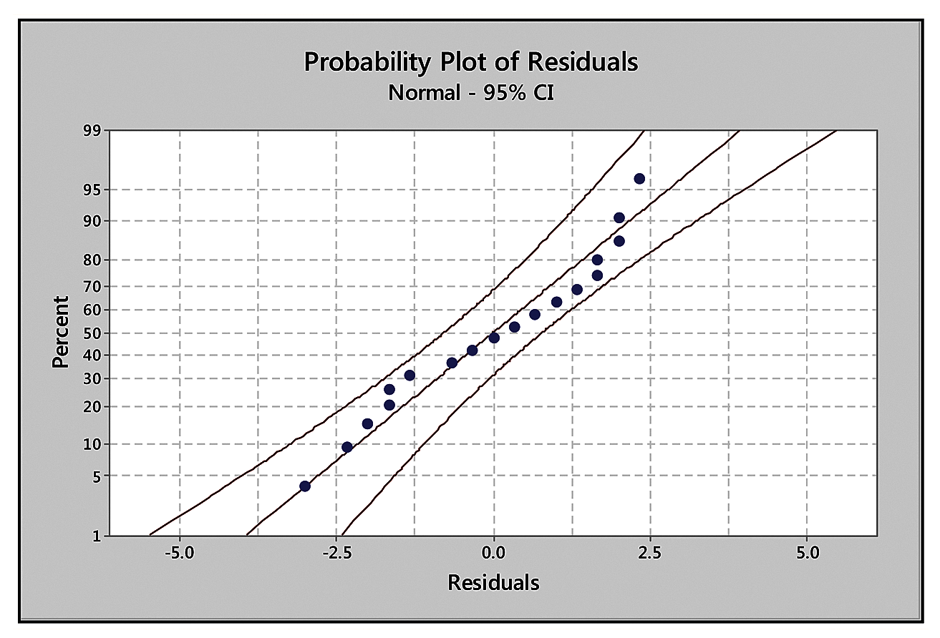
EXAMPLE Verifying the Normality Requirement in
(1 of 2) a Two-Way Analysis of Variance
Verify the normality requirement for the HDL data analyzed in the previous example.
The figure from
Minitab shows
the normal
probability plot
of the residuals.
13-114

Slide 115
EXAMPLE Verifying the Normality Requirement in
(2 of 2) a Two-Way Analysis of Variance
Because the residuals all lie within the confidence bands, the normality requirement is satisfied.
If we use StatCrunch to assess normality of the residuals, we find the correlation between the residuals and expected z-scores is 0.981. Because 0.981 > 0.946 (critical value from Table VI with n = 18), it is reasonable to conclude the residuals are normally distributed.
13-115

Slide 116
Objective 2
Draw Interaction Plots
13-116

Slide 117
Constructing Interaction Plots
Step 1 Compute the mean value of the response variable within each cell.
Step 2 In a Cartesian plane, label the horizontal axis for each level of factor A. Let the vertical axis represent the mean value of the response variable. For each level of factor A, plot the mean value of the response variable for each level of factor B. Draw straight lines connecting the points for the common level of factor B. You should have as many lines as there are levels of factor B. The more difference there is in the slopes of the lines, the stronger the evidence of interaction.
13-117

Slide 118
EXAMPLE Drawing an Interaction Plot
(1 of 5)
Draw an interaction plot for the data from a previous example, which is shown again below.
13-118

Slide 119
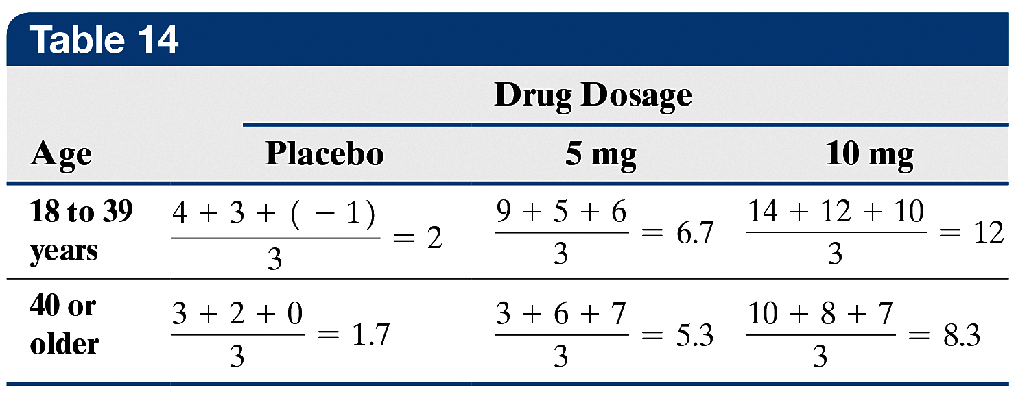
EXAMPLE Drawing an Interaction Plot
(2 of 5)
By Hand Solution
Step 1 Table 14 shows the mean value of the response
variable for each cell.
13-119

Slide 120
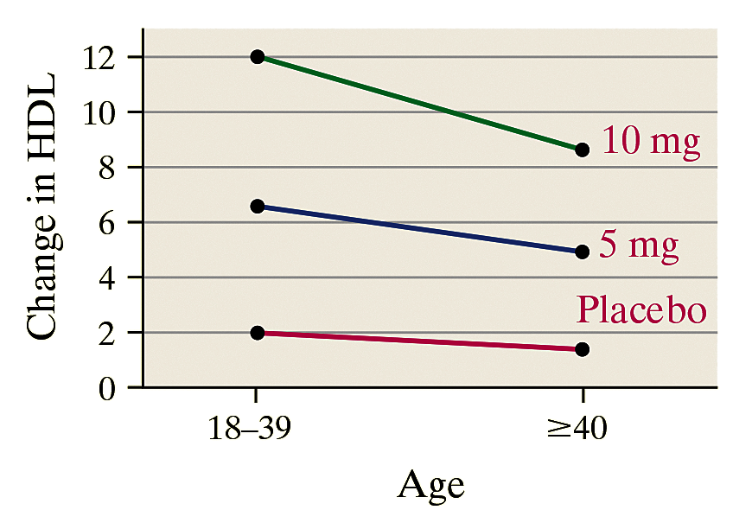
EXAMPLE Drawing an Interaction Plot
(3 of 5)
By Hand Solution
Step 2 Draw a Cartesian plane, label the horizontal axis Age, and indicate the levels 18 to 39 and 40 or older. The vertical axis is labeled as the response. For each age group, plot the mean values of the response variable for drug. Connect the points and label each line with its drug dosage.
13-120

Slide 121
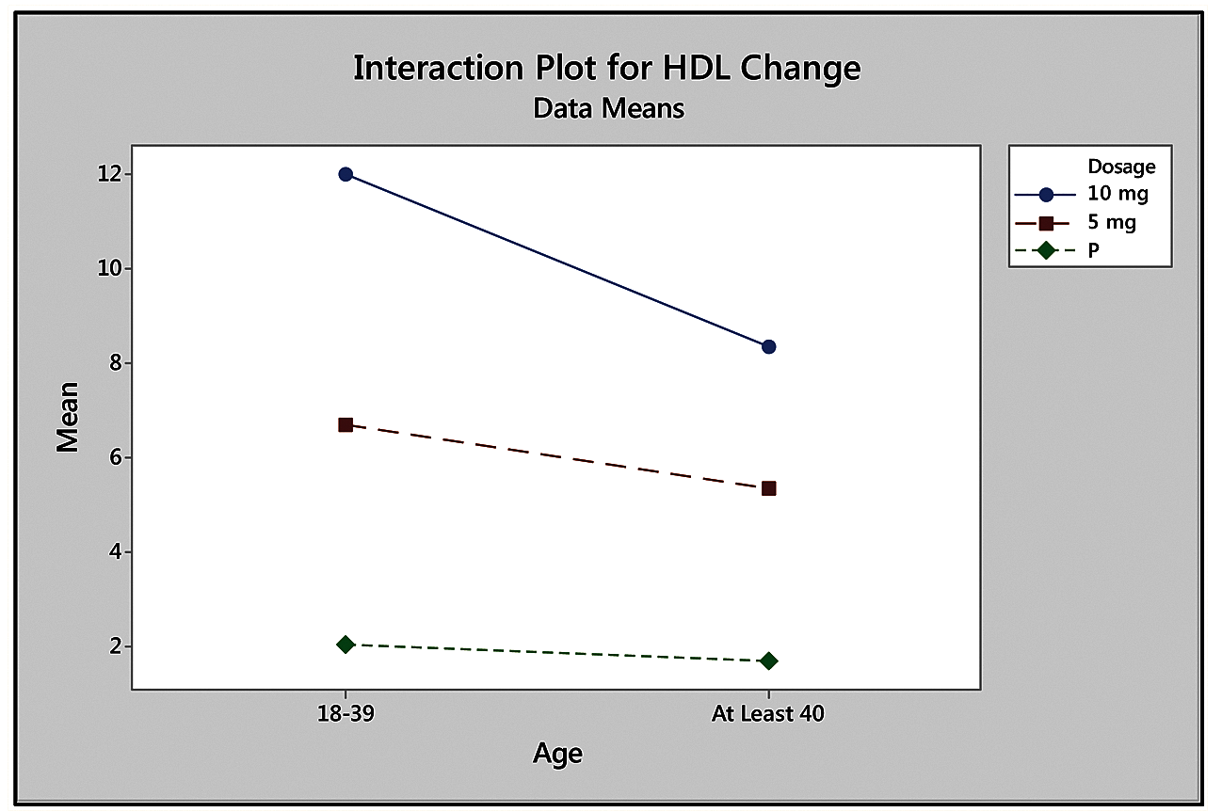
EXAMPLE Drawing an Interaction Plot
(4 of 5)
Technology Solution
The figure shows the interaction plot from Minitab using the data.
13-121

Slide 122
EXAMPLE Drawing an Interaction Plot
(5 of 5)
Interpretation When interpreting interaction plots, look at the level of parallelism among the lines. The more parallel the lines seem to be, the stronger the visual evidence is of no interaction.
From the figures shown, the roughly parallel lines verify our
conclusion of no interaction. Another bit of information that can be learned from the interaction plot is the effect age has on the response variable, change in HDL. Notice that change in HDL decreases as age increases. The increase in HDL cholesterol is largest for the 10-mg dose and smallest for the placebo.
13-122

Slide 123
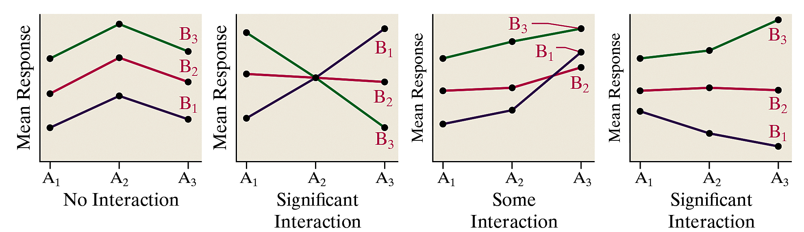
Some interaction plots are shown in the figure, where A₁, A₂, and A₃ represent three levels of factor A, and B₁, B₂, and B₃ represent three levels of factor B. Remember, although the interaction plots are meant to help us visualize the interaction (just as boxplots allow us to visualize differences among treatments in one-way ANOVA), they are not meant to be used to test for interaction. We can test for interaction by looking at the F-test statistic and its P-value for interaction in the ANOVA.
13-123

Slide 124
EXAMPLE Analyzing a 2 × 2 Factorial Design
(1 of 5)
An educational psychologist conducts an experiment to determine whether varying the conditions in which learning and testing take place affects test results. She randomly selects 20 students who are unfamiliar with the Battle at Gettysburg from the Civil War. After presenting the material to the students and allowing them ample time to study, the students are given an exam. Ten of the students receive the lecture in a large lecture hall and 10 receive the lecture in a small classroom (both lectures have the same instructor). Of the students in the large lecture hall, five take the exam in the same large lecture hall, and five take the exam in a small classroom. Of the students in the small classroom, five take the exam in a large lecture hall and five take the exam in the same small classroom. The experimental design is, therefore, a 2 × 2 factorial design with five replications in each cell.
13-124

Slide 125

EXAMPLE Analyzing a 2 × 2 Factorial Design
(2 of 5)
The table gives the scores for each student.
Preliminary analysis indicates that the requirements for conducting a two-way ANOVA are satisfied. Test whether there is an interaction effect between the lecture location and exam location. Draw an interaction plot to confirm your results.
13-125

Slide 126

EXAMPLE Analyzing a 2 × 2 Factorial Design
(3 of 5)
The figure shows the ANOVA from StatCrunch.
The P-value for the interaction effect is 0.0032, indicating that there is a significant interaction effect between lecture location and exam location. Therefore, we will not test the main effects.
13-126

Slide 127

EXAMPLE Analyzing a 2 × 2 Factorial Design
(4 of 5)
The figure shows the interaction plot from StatCrunch, which confirms the results from the ANOVA.
13-127

Slide 128
EXAMPLE Analyzing a 2 × 2 Factorial Design
(5 of 5)
The interaction plot suggests that students perform best if they take their exams in the same classroom where their lecture was given. The two high means are the means for (large lecture, large exam) and (classroom lecture, classroom exam).
13-128

Slide 129
Objective 3
Perform the Tukey Test
13-129

Slide 130
Once the null hypothesis of equal population means for either factor is rejected, we determine which means differ significantly using Tukey’s test. The steps are identical to those presented for one-way ANOVA.
However, the critical value is q_{α,ν,k} , where
α is the familywise error rate
ν = N – ab where N is the total sample size, a is the number of levels for factor A and b is the number of levels for factor B
k is the number of means being tested for the factor
13-130

Slide 131

The standard error is
where m is the product of the number of levels for the factor and the number of observations within each cell.
13-131

Slide 132
EXAMPLE Multiple Comparisons Using Tukey’s Test
(1 of 4)
Use statistical software to perform Tukey’s test to determine which pairwise means differ for the data presented in a previous example using a familywise error rate of α = 0.05.
13-132

Slide 133

EXAMPLE Multiple Comparisons Using Tukey’s Test
(2 of 4)
The figure shows the results of Tukey’s test using Minitab.
13-133

Slide 134
EXAMPLE Multiple Comparisons Using Tukey’s Test
(3 of 4)
For example, the confidence interval for μ_{p} – μ_{5 mg} does not contain 0 and is negative (lower bound: –7.2 mg/dL; upper bound: –1.1 mg/dL). Therefore, the mean increase in HDL cholesterol resulting from 5 mg of the drug is significantly greater than the mean increase due to the placebo.
The confidence interval for μ_{p} – μ_{10 mg} does not contain 0 and is negative. This indicates that the mean increase in HDL cholesterol resulting from 10 mg of the drug is also greater than the mean increase due to the placebo.
13-134

Slide 135
EXAMPLE Multiple Comparisons Using Tukey’s Test
(4 of 4)
Finally, μ_{5 mg} – μ_{10 mg} shows that the interval also does not contain 0, so the mean increase in HDL is higher with 10 mg than with 5 mg of the drug. Notice that the pairwise comparisons for age contains zero because we did not reject the null hypothesis H₀: μ_{18 – 39} = μ₄₀ or older for age.
13-135

